Slide 1
Deep Dive Into Virtual Kubelet

Slide 2


About Us
Lei (Harry) Zhang
Staff Software Engineer
Alibaba
@resouer
Jeremy Rickard
Senior Software Engineer
Microsoft
jeremy.rickard@Microsoft.com
@jrrickard

Slide 3
why are we here?

Slide 4
What is a kubelet?
kubelet
kube•let
noun
An agent that runs on each node in the cluster. It makes sure that containers are running in a pod.

Slide 5

How it works…
Kubelet
nodeName == “whatevs”

Slide 6

Scheduler

Slide 7
Kubelet
nodeName == “whatevs”
Container Runtime

Slide 8
Kubelet
nodeName == “whatevs”
Container Runtime

Slide 9
Kubelet
nodeName == “whatevs”
Container Runtime

Slide 10
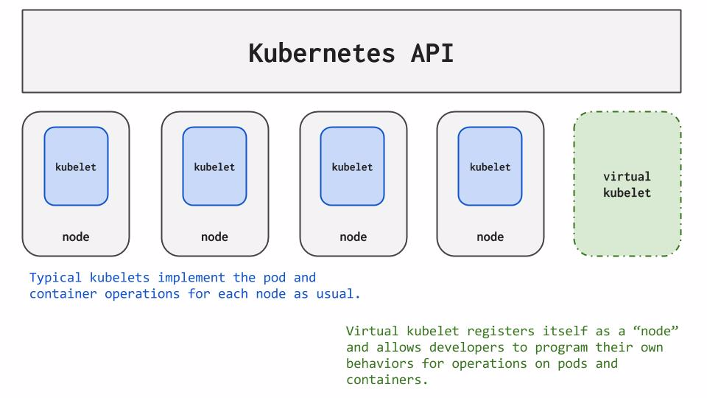
So what is a Virtual Kubelet?

Slide 11
When should I use it?
If you are working with a host/VM, use the Kubelet
Integrate at the CRI level
Else…
Send Kubernetes workloads to any service you like
Burst to cloud Container as a Service or other serverless platforms
Bridge to another orchestrator
Schedule to IoT control planes
Order pizza

Slide 12
How it works

Slide 13

How it works

Slide 15
How it actually works…
Virtual-Kubelet
nodeName == “virtual-kubelet”

Slide 16
How it actually works
Scheduler

Slide 17
How it actually works
Virtual-Kubelet
nodeName == “virtual-kubelet”
External Service

Slide 18
How it actually works
Virtual-Kubelet
nodeName == “virtual-kubelet”
External Service

Slide 19
How it actually works
Virtual-Kubelet
nodeName == “virtual-kubelet”
External Service

Slide 20
Anatomy of a Virtual Kubelet
Virtual-Kubelet Daemon
nodeName == “virtual-kubelet”
The Framework
The Provider

Slide 21
VK Framework
Works from shared informer cache
State Reconciliation
HTTP Server
Tracing
Logging

Slide 22
What’s a Provider?
Provide the back-end plumbing necessary to support the lifecycle management of pods, containers and supporting resources in the context of Kubernetes.
Conform to the current API provided by Virtual Kubelet.
No direct access to Kubernetes API

Slide 23


Current Providers
Alibaba
Azure – ACI
Azure - IoT Edge
AWS
HashiCorp Nomad
Huawei
OpenStack Zun

Slide 24
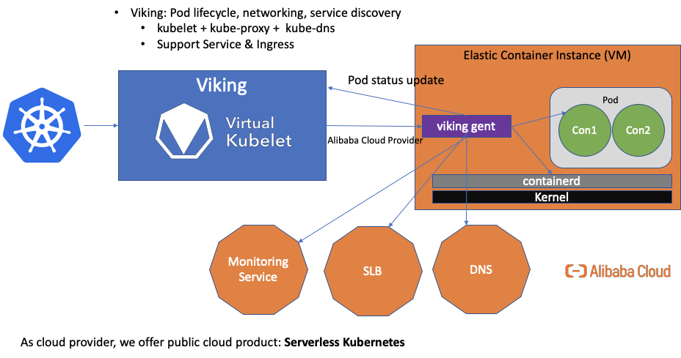
How Alibaba Use Virtual Kubelet?

Slide 25
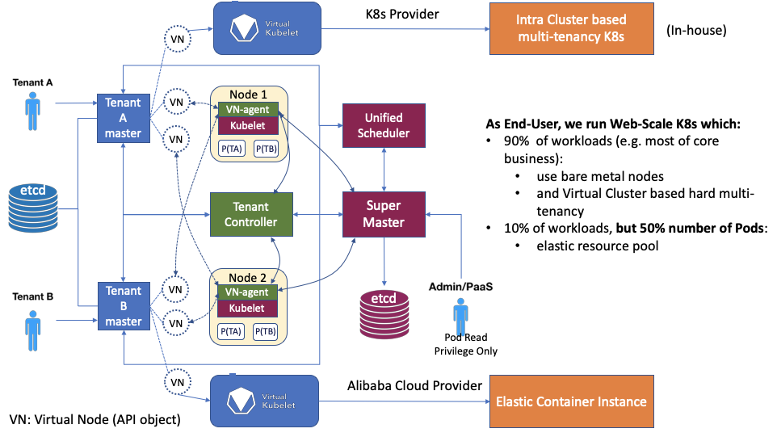
Alibaba Provider Use Cases

Slide 26
VK Provider API
Code example!

Slide 27
Join Us!
http://github.com/virtual-kubelet/virtual-kubelet
Slack channel in Kubernetes #virtual-kubelet
VK Community meetings every other week on Tuesday’s at 11am PST
Virtual Kubelet is a CNCF Sandbox project!

Slide 28
Q&A

